Slide 1
Data Science Internship
Charlie Onaitis

Slide 2

Website Overview
C3 - The Answer

Slide 3
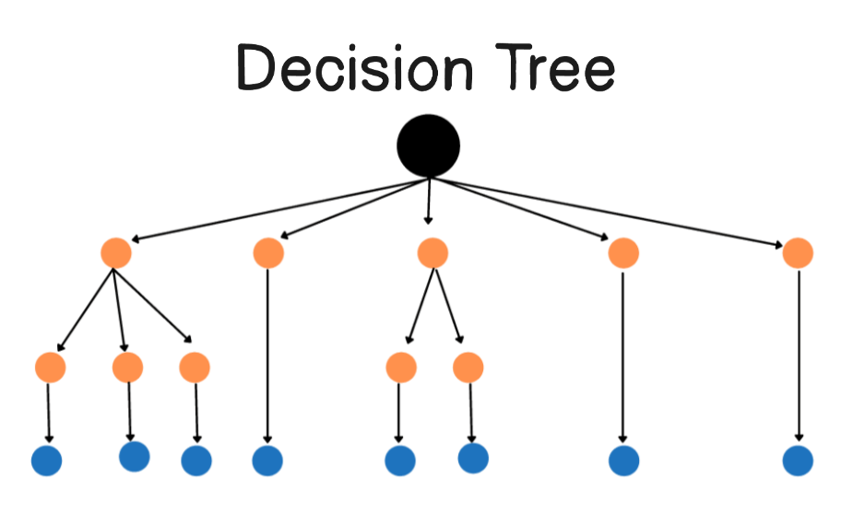
How the model works

Slide 4
We start with past case data We combine legal details (like court, judge, type of violation) and financial details (like market cap drop, short %, revenue) for thousands of cases.
The model looks for patterns We train a “Random Forest” — which is basically a big group of “yes/no question” trees. Each tree asks different questions in a different order, like: “Was it in this court?” → “Was the market cap drop above 20%?” → “Was there an SEC action?” At the end of each tree, it gives its own guess on whether the case was Settled, Dismissed, or Other.

Slide 5
Every tree gets a say When we predict a new case, we send it down every tree.
Each tree votes for an outcome
We average all the votes to get final percentages for each possible outcome.
The biggest patterns matter most If certain features (like SIC Code or SEC Action) show up near the top of many trees, they shape the result more. But smaller details can still tip the scales when combined with others.
The prediction is based on similar situations The model doesn’t need an exact match from history. It looks at many similar cases and averages how they turned out.

Slide 6
When a less important feature can matter a lot
If your chosen filters pin the case into a branch where the high-importance features are already fixed (e.g., SIC Code, Federal Court already decided), the model has to split on whatever’s left.
In that smaller subgroup, a lower-importance feature might create a big purity drop and strongly influence the prediction for that subset of cases.
In those situations, that feature can change the outcome significantly — even if, in the forest as a whole, it doesn’t matter much

Slide 7
Why Less Important Features Still Matter
Importance ≠ Always Relevant A low-importance feature means it on average reduces uncertainty less than others — not that it’s useless.
Context Matters Once high-importance features (like SIC Code, Court) are fixed by filters, lower-importance features can become decisive.
Example: Normally, “Transactional” has low importance. But if you’ve already fixed SIC Code = 3841 and Court = SDNY, “Transactional” might split the remaining cases cleanly and swing the prediction.
Takeaway: Smaller features can matter a lot when the bigger ones are already locked in.

Slide 8
Why Predictions Change When Filters Change
All Trees Are Always Used Your filters don’t remove trees — they just change the path your case takes down each one.
Path Changes = Leaf Changes A filter tweak can send your case into a different “leaf” in many trees, where the settlement/dismissal percentages are different.
Average of Votes Changes Each tree’s leaf “votes” for an outcome. Change enough leaves → the average outcome shifts.
Key Insight: Even if the filters seem small, they can push the case into a very different set of similar historical cases.

Slide 9
Notable Findings
SEC Action as yes: 92% settlement rate (53 cases)
Phase 3 Cases: 82% dismissal rate
Proposed transaction cases: 93% Dismissal Rate
Delaware Federal Court has 95% dismissal Rate (406 cases)
Massachusetts Federal Court has 81% dismissal Rate (132 cases)
Judge Leonard P. Stark has 96% dismissal rate (92 cases)
Judge Richard G. Andrews has 93% dismissal Rate (91 cases)
Colm F. Connelly has 100% dismissal rate (79 cases)
Maryellen Noreika has 97% dismissal Rate (76 cases)

